Slide 1
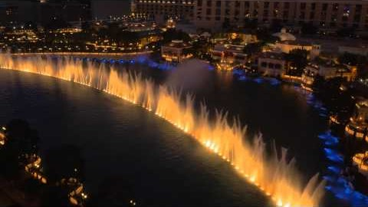

2. For emphasis
“Las Vegas is very expensive,
but I really want to see the hotels.
And this show would be so cool!”

Slide 2
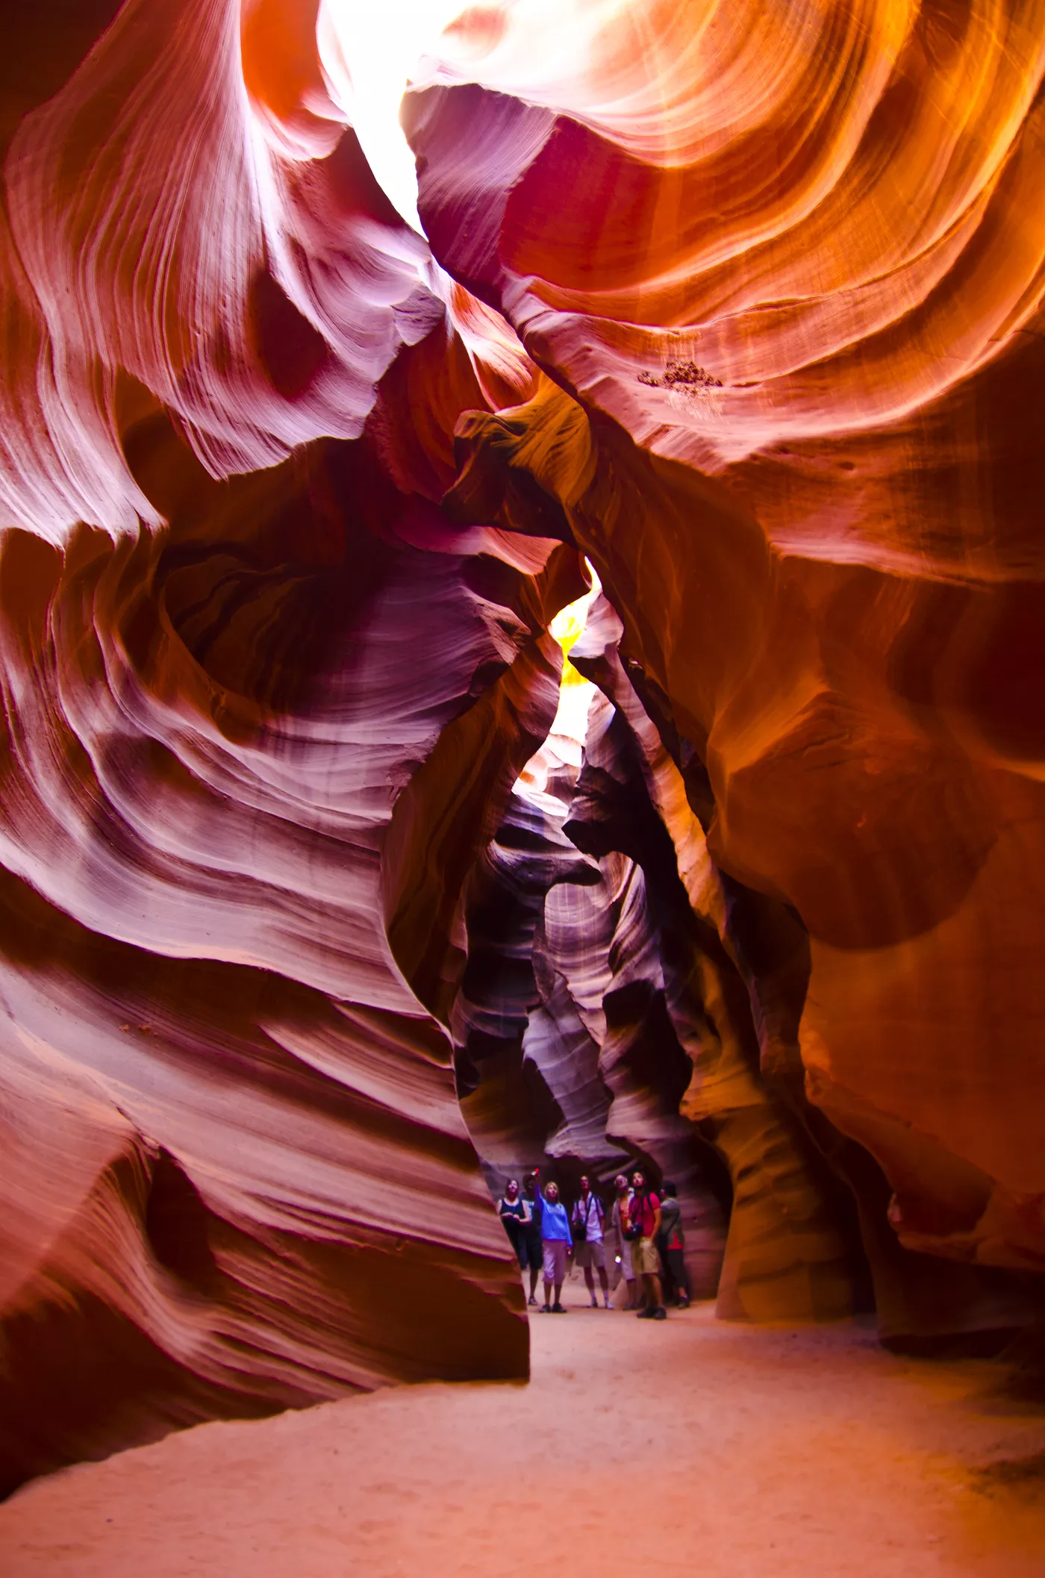
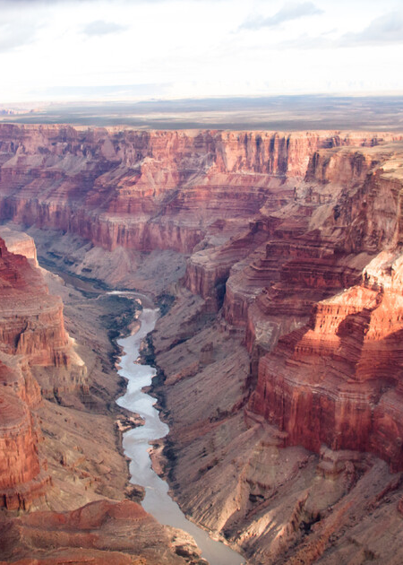
3. Correcting and disagreeing
A: “Let’s travel to New Mexico. I want to see the Grand Canyon.”
B: “The Grand Canyon is in Arizona, not New Mexico.”
A: “Okay, well let’s go.”

Slide 3
3. Correcting and disagreeing
B: “Okay. But we should go to Antelope Canyon. It’s cooler in my opinion.”
A: “Okay, but it’s safer to go to the Grand Canyon.”

