Slide 1
Pronunciation: Focus
Sara Hanson-Lynn, Summer GECO, July 2020
Referenced: Yoshida, M. T. (2016). Beyond repeat after me: Teaching pronunciation to English learners. Alexandria, Virginia: tesolpress.

Slide 2
We have learned…
Syllables
Stressed syllables: longer/shorter, higher/lower, softer/louder
Stress-
timed
Length = # of stresses/syllables
Content words (n___, main verbs, a________, adverbs, or q_____ words) are less/more important
e.g. “register”
e.g. “different” “Serena”
“Unstressed syllables (sometimes disappear/important, pronounced clearly/made into a /ə/)
e.g. “What are you doing?” “I have to study some math.”

Slide 3
The next step
Syllables
Stressed syllables: longer/shorter, higher/lower, softer/louder
Stress-
timed
Length = # of stresses/syllables
Content words (nouns, main verbs, adjectives, adverbs, or question words) are less/more important
Focus
A certain content word in the sentence is stressed
e.g. “register”
e.g. “different” “Serena”
“Unstressed syllables (sometimes disappear/important, pronounced clearly/made into a /ə/)
e.g. “What are you doing?” “I have to study some math.”

Slide 4
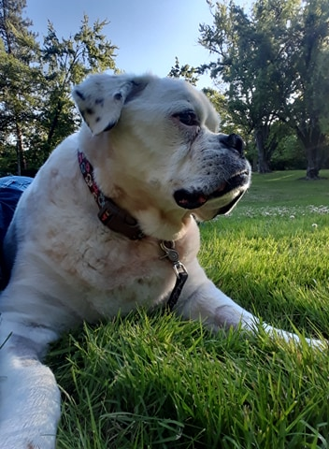

Focus
“Is this your dog?”
“I am so hungry.”
“We’re going to be late.”

Slide 5

Which word is the ‘focus’?

Slide 6
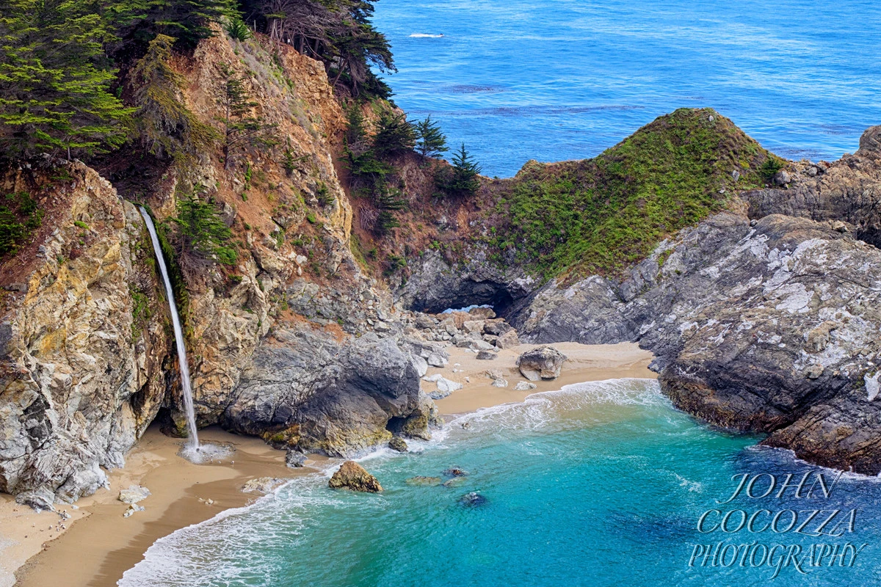
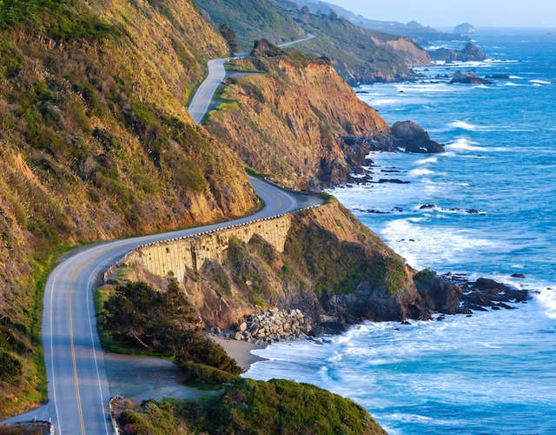
1. The “Last Word”
Usually, the last content word in the sentence is stressed.
Content words =
Big Sur is in California.
Highway 101 is famous.
You can see a waterfall.

